Slide 1


1 Peter 5:1-14

Slide 2
The Salvation of the Soul

Slide 3

Salvation of the Soul
1 PETER
What is the Salvation of the Soul?
The Salvation of the soul is the total transforming work of God upon our lives, which is presently being realized in the midst of Christ like suffering, and which in the future will be unveiled in Christ like glory.

Slide 4
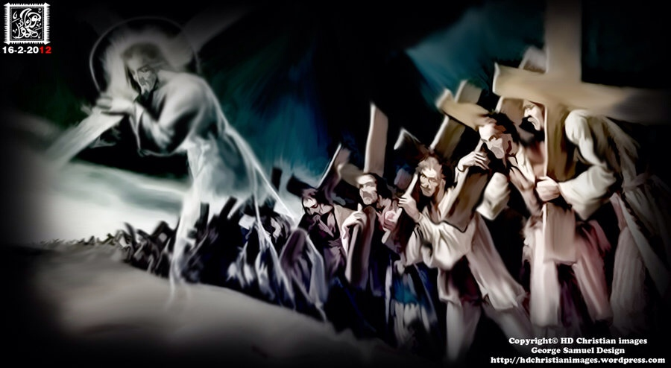
Salvation of the Soul
1 PETER
We are called to patiently endure unjust suffering just as Christ showed us the way to suffer.
Notes:
The example set before us is set in the past. Jesus shows us the way to suffer, to die, to live. We follow Him in the way to suffer and in the way of submission. Christ’s sufferings are the model on how to respond to injustice, for He experienced the greatest injustice of all. So we too are told to take up your suffering and follow Him in His footsteps. There are many others in the past who have taken up their crosses and suffered for Him patiently, will you do the same?

Slide 5
Salvation of the Soul
1 PETER
Outline

Slide 6
Salvation of the Soul
1 PETER
Preface: Salvation of the Soul, Our Hope
and Goal – 1:3-12
Body: Salvation of the Soul, Worked out in
Experience in Relation to: God,
the Brethren, the World, Life in General,
and the Conclusion of All Things - 1:13 - 4:19
Epilogue: A Word of Exhortation – 5:1-11

Slide 7
Salvation of the Soul
1 PETER
Epilogue: A Word of Exhortation – 5:1-11
to the Elders – 5:1-4
to the Young Men – 5:5
to All: Be Humble and Prepared – 5:6-11
Farwell Greeting and Peace - 5:12-14

Slide 8

Salvation of the Soul
1 PETER
In Relation to the End through Service to God
“But the end of all things is at hand; (4:7a)
“the end” – “telos” - the conclusion of an act or state; (termination) the result.
The Question is, what is the end of all things, and is it the same as the end of the age?
Notes:
Question? What is the end of all things and is it the same as the end of the age? The answer to the second part is, No! To answer this question we have to look at Daniel 9.

Slide 9
Salvation of the Soul
1 PETER
Daniel’s Vision – 9:24-27
“from”
“until”
“then”
444 BC
33 AD
“end”
“after”
490 Y
70 years
483 Y
7 Y
? Y
No Rest
Captivity
No Rest
[Church]
signs
Rebuild the City
Completion
(7 x 7 = 49) + (7 x 62 = 434) + (7) = 490 Years

Slide 10
Salvation of the Soul
1 PETER
Daniel’s Vision – 9:24-27
“Seventy weeks [sevens] are determined for your people and for your holy city…
“…Even until the consummation, which is determined, is poured out on the desolate.“ (7:27b)
This is the End of the Age Accompanied by Signs and Wonders
Notes:
The end of the age is the end of the seventy sevens.

Slide 11
Salvation of the Soul
1 PETER
“the end of all things is near” (1 Peter 4:7)
The End of the Age
New Heaven and Earth
“no signs”
“signs”
483 Y
? Y
7 Y
1000 Y
Eternity
No Rest
Church
Day of the LORD
Kingdom
Day of the God
The Completion of All Things
Notes:
The end of the age is the end of the seventy sevens, and at that time Christ will personally appear in glory returning to the earth and establish His kingdom rule over the all earth. But it is not the end of all things. The conclusion of all thing occurs at the end of millennial reign just prior to creation of the new heaven and earth.
The Day of the Lord, Daniel’s seventieth seven, the Coming of the Lord in wrath is preceded by no signs. The Day of LORD and Jesus, the Christ will come like a thief in the night. This why we need to be watching and alert in prayer like Daniel.
If we are seeing “signs” today of His coming as a thief in the night, then He is a bad thief, tipping off when He is coming. The signs are for that generation that will be living during the fulfillment of Daniel’s seventieth seven.

Slide 12
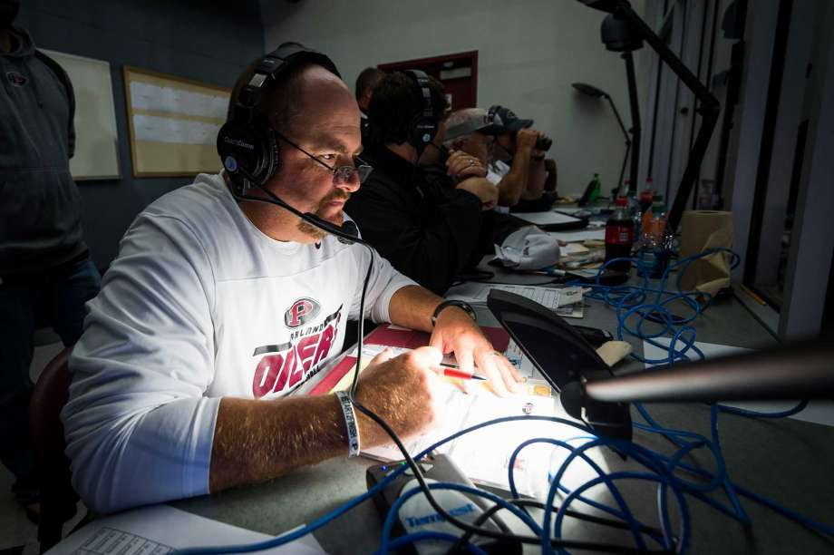
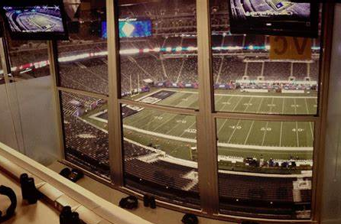
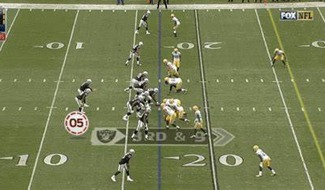
Salvation of the Soul
1 PETER
Christ’s Management in the Church
Offensive Coordinator
The Dispensation
of the Grace of God
Notes:
A football analogy… showing the different management types or the dispensing of God’s rule in the church age and the kingdom age.

Slide 13
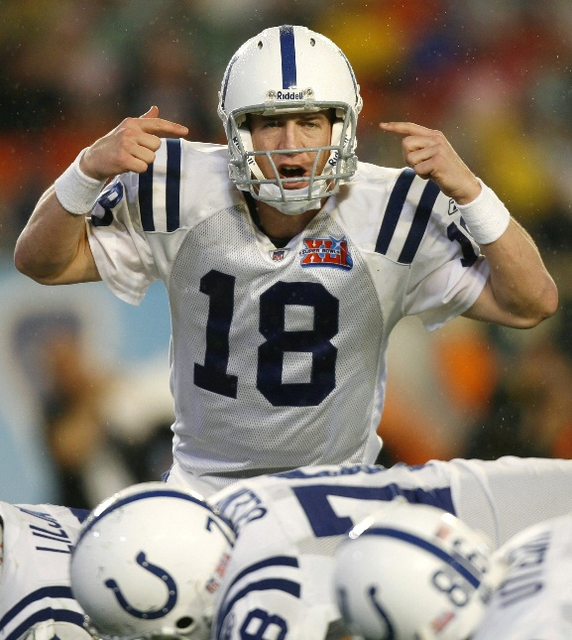
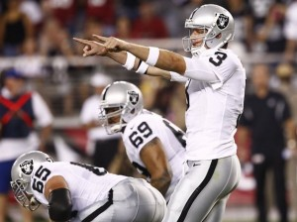
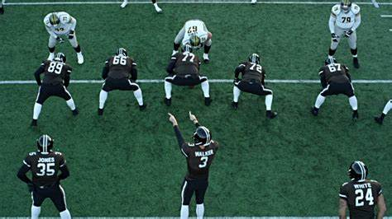
Salvation of the Soul
1 PETER
Christ’s Management in the Kingdom
Quarterback Calls Plays
on the Field
The Dispensation
of the Fullness of Times
Notes:
This is Christ’s administration of His government during the completion of all things, “the end times”. After the Rapture of the Church, the dispensation of the fullness of times extends from the beginning of the Day of the Lord, (the Tribulation, 70th seven) until the end of the Millennium, until the creation of the new heaven and earth, the Day of God. This will all occur during His Second Advent, Arrival, or Coming. His Second Coming ought not to be just thought of as a single event, but His personal and physical return to the earth is accompanied by these other events.

Slide 14
Salvation of the Soul
1 PETER
Body: Salvation of the Soul, Worked out in Experience – 1:13 – 4:19
In Relation:
to the Consummation of History – 4:7-19
through Service to God – 4:7-11
through Suffering for God – 4:12-19

Slide 15



Salvation of the Soul
1 PETER
In Relation to the End through Service to God
With Prayer – 4:7b
With Love – 4:8
With Hospitality – 4:9
With His Gift – 4:10-11a
All for the Glory of God – 11:b
Notes:
Since the end of all things is near this leads us to soberness and prayer, (7b) love and hospitality, (8-9) and to God honoring service (10-11).
Peter describes how to live life with an end-time perspective.

Slide 16

Salvation of the Soul
1 PETER
In Relation to the End through Suffering for God
With Great Rejoicing – 4:12-13
With Anticipated Blessing – 4:14
Not as an Evil Doer, but as a Christian– 4:15-16
With Coming Judgment in Mind - 4:17-18
With Commitment to God - 4:19

Slide 17
Salvation of the Soul
1 PETER
Epilogue: A Word of Exhortation – 5:1-11
to the Elders – 5:1-4
to the Young Men – 5:5
to All: Be Humble and Prepared – 5:6-11
Farwell Greeting and Peace - 5:12-14

Slide 18
Salvation of the Soul
1 PETER
Epilogue: A Word of Exhortation – 5:1-11
To the Elders: Shephard the Flock – 5:1-4
“The elders who are among you I exhort, I who am a fellow elder and a witness of the sufferings of Christ, and also a partaker of the glory that will be revealed:” (5:1)
Notes:
The main argument of the letter now being concluded Peter extends specific admonitions to his readers/pilgrims. The whole section shows Peter’s care and concern for the Lord’s sheep, whom He had instructed Peter to feed.
Peter addresses the “elders” (presbuteros) meaning “older man” or the more dignified term “senior”; “Presbyterian” is a church managed by elders (presbuteros).
Peter “exhorts” “parakaleo” calls or invites these elders of the churches to come near to shepherd the flock. This is the “call” to the ministry by Peter. He does so as a fellow elder, “copresbyter”, pointing out their mutual responsibilities from God.
He speaks to them from experience, reminding them of his role as a witness of the sufferings of Christ and Peter was witness from the beginning, from the baptism of John until He was taken up (Acts 1:21-22).
Peter also tells them he is also a “partaker” - “koinonos” a sharer, companion, fellowship, or partner in glory that is to be “revealed” - “apokalupto” – the glory that is about to be “uncovered”.
Peter had just made the point that those who share in Christ’s suffering will also share in His glory (4:13) Peter was confident in the precious promise of the Lord that he would share this glory since he had shared in His the Lord’s suffering by beatings and imprisonment (Acts 5:40).

Slide 19
Salvation of the Soul
1 PETER
Epilogue: A Word of Exhortation – 5:1-11
To the Elders: Shephard the Flock – 5:1-4
“Shepherd the flock of God which is among you, serving as overseers, not by compulsion but willingly, not for dishonest gain but eagerly; nor as being lords over those entrusted to you, but being examples to the flock;” (5:2-3)

Slide 20
Salvation of the Soul
1 PETER
Epilogue: A Word of Exhortation – 5:1-11
To the Elders: Shephard the Flock – 5:1-4
“not by compulsion”
“not for dishonest gain”
“nor as being lords over
those entrusted to you,”
“but willingly,”
“but eagerly”
”but being examples
to the flock”
Notes:
Peter’s call to the elders was given in three pairs of negatives and three pairs of positives.
The exhortation reflects Ezekiel 34:1-16 were false shepherds were contrasted with true shepherds,

Slide 21
Salvation of the Soul
1 PETER
Prophecy Against False Shepherds:
“Woe to the shepherds of Israel who feed themselves!... You eat the fat and clothe yourselves with the wool; you slaughter the fatlings, but you do not feed the flock…”

Slide 22
Salvation of the Soul
1 PETER
Prophecy Against False Shepherds:
“The weak you have not strengthened, nor have you healed those who were sick, nor bound up the broken, nor brought back what was driven away, nor sought what was lost; but with force and cruelty you have ruled them… So they were scattered because there was no shepherd;…” (Ezek. 34:1-5a)

Slide 23
Salvation of the Soul
1 PETER
Prophecy of the True Shepherd:
“Indeed I Myself will search for My sheep and seek them out. As a shepherd seeks out his flock on the day he is among his scattered sheep, so will I seek out My sheep and deliver them from all the places where they were scattered…” (Ezek. 34:11-16)

Slide 24
Salvation of the Soul
1 PETER
Epilogue: A Word of Exhortation – 5:1-11
To the Elders: Shephard the Flock – 5:1-4
“Shepherd the flock of God which is among you, serving as overseers, not by compulsion but willingly, not for dishonest gain but eagerly; nor as being lords over those entrusted to you, but being examples to the flock;” (5:2-3)
Notes:
Peter calls them to “shepherd” the “sheep” or tend to and serve the church as a shepherd would care for his sheep, that is, feeding, caring, leading, guiding, and protecting them from danger. These are all the responsibilities and duties of a pastor. A shepherd was to do so with those who were “among them” their “parish”.
Shepherd or pastoring is to be done by “serving as overseers“ (episkopoúntes
- all one word in Greek) They are “overseers” (episkopeo - Episcopalian) translated elsewhere as “bishop”. The elders were to “serve”, (better) “taking” or “exercising oversight” [NASB] those given to their care.
With contrasting exhortations Peter presents both the wrong and right motive and the manner of their responsibilities of their calling…
They should not feel as if they are being force to lead, not from a sense of external pressure, but to do so willingly, voluntarily, eagerly and ready to serve. Dirty money or greed, social or financial pressures should not be a motivating factor in their decision in pastoring the church. Pastors who serve with false motives care only for themselves and devour the flock.
Pastors are not to be dictatoral, domineering and controlling the lives of their parish. Leading the flock by example “typoi”. They are to be the model to follow. In contrast, the false shepherds ruled harshly and brutally.
Pastors are “not to drive God’s people, but to lead them by their example of mature Christian character.” (BKC, p. 856)

Slide 25
Salvation of the Soul
1 PETER
Epilogue: A Word of Exhortation – 5:1-11
To the Elders: Shephard the Flock – 5:1-4
“and when the Chief Shepherd appears, you will receive the crown of glory that does not fade away.” (5:4)
Notes:
Peter, as well as all pastors are simply undershepherds, the Chief Shepherd is Christ Himself is certain to appear. A fact that the false shepherd and teachers, “the scoofers” are said to deny, which is the occasion for Peter’s second letter to his readers.

Slide 26
Salvation of the Soul
1 PETER
Epilogue: A Word of Exhortation – 5:1-11
To the Elders: Shephard the Flock – 5:1-4
“Chief Shepherd” – 1 Peter 5:4
“True Shepherd” – Ezekiel 34:11-16
“Good Shepherd” – John 10:11, 14
“Great Shepherd” – Hebrews 13:20
Notes:
Christ is also called the…

Slide 27
Salvation of the Soul
1 PETER
Epilogue: A Word of Exhortation – 5:1-11
To the Elders: Shephard the Flock – 5:1-4
“and when the Chief Shepherd appears, you will receive the crown of glory that does not fade away.” (5:4)
Notes:
Peter concludes with a reminder to the undershepherds that a reward for faithful service and oversight is waiting for them. The Chief Shepherd, Jesus Himself will judge the quality of their oversight, when he “shall appear” in the future. If they are found worthy they will receive an unfading “crown of glory”.
This crown (stephanos) a wreath made of twine placed on the head of the victory as a prize of honor in the public games. The “stephanos” given to faithful pastors is the prize that will never diminish in glory, it is an eternal reward. This is honor from Christ Himself for a job well done!

Slide 28
Salvation of the Soul
1 PETER
Epilogue: A Word of Exhortation – 5:1-11
To the Young Men: Submit Yourselves – 5:5
“Likewise you younger people, submit yourselves to your elders. Yes, all of you be submissive to one another, and be clothed with humility, for ‘God resists the proud, but gives grace to the humble.” (5:5)
Notes:
Peter now address the sheep. Good leaders need good followers. Sheep have responsibilities too, which they themselves will be held accountable for. The younger members are to “subject” (hupotasso) to place themselves willingly under, not over, the authority of those who had been given to them, to instruct them and lead them.
Peter exhorts them to “cloth” themselves with humility. This concern for humility recalls Luke 22:24-25 and John 13. The verb “be clothed” recalls the towel of slaves, used by the Lord to teach a lesson of humility to Peter and the rest of the Disciples (Jn. 13:4).
Peter quotes Proverbs 3:34 to emphasize the Lord’s attitude toward the proud and the humble. He opposes, “sets Himself against” the arrogant but grants favor and acceptance to the humble. Does God have favorites? Yes He does! The humble are His favorites. And He spoils His favorites!

Slide 29
Salvation of the Soul
1 PETER
Epilogue: A Word of Exhortation – 5:1-11
To All: Humble Yourselves – 5:6-7
“Therefore humble yourselves under the mighty hand of God, that He may exalt you in due time, casting all your care upon Him, for He cares for you.” (5:6-7)
Notes:
The sheep are not only under the shepherds, but are to remember that ultimately they under God’s sovereign rule. It is God who gave them the shepherds to begin with. So, “allow yourselves to be humble”.
“Those who were suffering persecution for Christ’s sake could be encouraged by the fact that the same mighty hand that let them suffer would one day lift them up.” (BKC. P. 856) “Humble yourselves in the sight of the Lord, and He will lift you up.” (James 4:10) they will be exalted. “For whoever exalts himself will be humbled, and he who humbles himself will be exalted.” (Luke 14:11; 18:14)
“Blessed is the man who endures temptation; for when he has been approved, he will receive the crown of life which the Lord has promised to those who love Him.” (James 1:12)
Then Peter quotes Psalm 55:22, “Cast your burden (care) on the Lord, and He shall sustain you; He shall never permit the righteous to be moved.” This is reminiscent of the Jesus’ words in the Sermon of the Mount,

Slide 30
Salvation of the Soul
1 PETER
“Therefore I say to you, do not worry about your life, what you will eat or what you will drink; nor about your body, what you will put on. Is not life more than food and the body more than clothing? Look at the birds of the air, for they neither sow nor reap nor gather into barns; yet your heavenly Father feeds them. Are you not of more value than they?” (Matthew 6:25-26)
Notes:
“Therefore I say to you, do not worry about your life, what you will eat or what you will drink; nor about your body, what you will put on. Is not life more than food and the body more than clothing? Look at the birds of the air, for they neither sow nor reap nor gather into barns; yet your heavenly Father feeds them. Are you not of more value than they?” (Matt 6:25-26)

Slide 31
Salvation of the Soul
1 PETER
Epilogue: A Word of Exhortation – 5:1-11
To All: Humble Yourselves – 5:6-7
“Therefore humble yourselves under the mighty hand of God, that He may exalt you in due time, casting all your care upon Him, for He cares for you.” (5:6-7)
Notes:
In the midst of suffering one may not maintain the belief that God still loves and care for them. But God is not like a shifted shadow. God is good! And He is always good! Amen!

Slide 32
Salvation of the Soul
1 PETER
Epilogue: A Word of Exhortation – 5:1-11
To All: Be Prepared for the Devil – 5:8-9
“Be sober, be vigilant; because your adversary the devil walks about like a roaring lion, seeking whom he may devour. Resist him, steadfast in the faith, knowing that the same sufferings are experienced by your brotherhood in the world.” (5:8-9)
Notes:
Though believes should place all their care to the Lord they ought not to be careless.
Be sober, alert and prepared, for the conclusion of all things in near, and Satan, the adversary, (one who opposes, “antidokos”) who is also the devil, (deceiver, slanderer, liar, “diabolos”), roars like a hunger lion, ready to destroy morally those who fall victim to his schemes, to deprive the Christian, their Salvation of the Soul.
To be watchful and ready Peter is recalling the Lord’s words in Luke 12:37-40…

Slide 33
Salvation of the Soul
1 PETER
“Blessed are those servants whom the master, when he comes, will find watching. Assuredly, I say to you that he will gird himself and have them sit down to eat, and will come and serve them. And if he should come in the second watch, or come in the third watch, and find them so, blessed are those servants….”
Notes:
“Blessed are those servants whom the master, when he comes, will find watching. Assuredly, I say to you that he will gird himself and have them sit down to eat, and will come and serve them. And if he should come in the second watch, or come in the third watch, and find them so, blessed are those servants….”

Slide 34
Salvation of the Soul
1 PETER
“But know this, that if the master of the house had known what hour the thief would come, he would have watched and not allowed his house to be broken into. Therefore you also be ready, for the Son of Man is coming at an hour you do not expect.” (Luke 12:37-40)
Notes:
But know this, that if the master of the house had known what hour the thief would come, he would have watched and not allowed his house to be broken into. Therefore you also be ready, for the Son of Man is coming at an hour you do not expect.” (Luke 12:37-40
The coming of the Day of the Lord and the coming of the Son of Man are one and the same, both come expectantly.

Slide 35
Salvation of the Soul
1 PETER
Epilogue: A Word of Exhortation – 5:1-11
To All: Be Prepared for the Devil – 5:8-9
“Be sober, be vigilant; because your adversary the devil walks about like a roaring lion, seeking whom he may devour. Resist him, steadfast in the faith, knowing that the same sufferings are experienced by your brotherhood in the world.” (5:8-9)
Notes:
The devil should be resisted (antistete), “to withstand”, a defensive term. We are not to run toward the roar and attack Satan, but stand firm against him.
And Peter reminds them that they do not stand alone.

Slide 36
Salvation of the Soul
1 PETER
Epilogue: A Word of Exhortation – 5:1-11
To All: Be Prepared for Glory – 5:10-11
“But may the God of all grace, who called us to His eternal glory by Christ Jesus, after you have suffered a while, will Himself perfect, establish, strengthen, and settle you. To Him be the glory and the dominion forever and ever. Amem.
Notes:
These verses comprise a doxology in which God’s gracious purposes in our suffering are celebrated. Peter has encouraged his readers to endure suffering and if they humble themselves and continue to trust in Him the God of all grace will exalt and glorify them in due time. In a benediction form Peter briefly summarizes his message of encouragement.
First of all Christian suffering is only “for a little awhile”, while their glory in Christ in which they were called is forever. After they, you, me, us have suffered for a little while, God Himself will make us perfect, not sinless perfection, but bring us to maturity and completion (katartizo- to complete thoroughly, to repair or restore). He will then establish us (producing stability) and make us strong, enabling us to stand firm and steadfast. God is able to keep us standing with solid footing so that we may not be moved from our faith in Him by Satan deceptions.
Peter does not request that we be removed from trials, but that we may endure them victoriously. We should not so much ask God to remove the trial from us, but to ask how we can glorify God through it.
All of this is on the basis of Who Christ is, the one who possesses all the glory and power forever. He certainly has the power and the wisdom to strength those who are suffer trials and tribulations for His sake.

Slide 37
Salvation of the Soul
1 PETER
Farwell Greeting and Peace - 5:12-14
“By Silvanus, our faithful brother as I consider him, I have written to you briefly, exhorting and testifying that this is the true grace of God in which you stand.” (5:12)
Notes:
Peter now wish to personally recognize his secretary, Silvanus, also the bearer of the letter, along with greetings from his family. Silvanus is a longer version of Silas, which is usually identified with the Silas of Acts, a frequent companion of Paul. Probably not the same for Silvanus was a common name in those days.
He was a faithful brother, as Peter considered him.

Slide 38
Salvation of the Soul
1 PETER
Farwell Greeting and Peace - 5:12-14
“She who is in Babylon, elect together with you, greets you; and so does Mark my son. Greet one another with a kiss of love. Peace to you all who are in Christ Jesus. Amen.” (5:13-14)
Notes:
Many believer that “the elect” refers to the Church from which Peter wrote, and “John Mark”, Peter’s cousin, and Peter’s interpreter (according to Papias). Some others believe that “the elect” refers to “she” his wife and “my son” to Peter’s physical son, named after john Mark.
The location of “Babylon” has three possibilities. Some suggest it refers to the historical Babylon in Mesopotamia where there was still in Peter’s day a large Jewish settlement. Others propose it refers to a city in Egypt by the same name. And the most popular is that it is code for Rome.
There is no historical evidence from the writers of the early church fathers that Peter was ever in historic Babylon. That does not mean it is still possible. There was still a large Jewish presence in physical Babylon in the 1st century. Peter was the apostle to the Jews.

Slide 39
Salvation of the Soul
1 PETER
Conclusion
Notes:
Peter’s letter has shown us how to do good or well in every area of our present experience. We have seen how to do well in regard to God, the church, the world, to life in general and in the light of the end of all things. If in all these areas we indeed so well/good, the soul is safe in the hands of a trustworthy and loving God. He will preserve our soul and save it so that it may survive even death itself and appear to His eternal glory in the age to come. “He that doeth the will of God abides forever.” (1 Jn. 2:17)

Slide 40
Salvation of the Soul
1 PETER
What is the Salvation of the Soul?
The Salvation of the soul is the total transforming work of God upon our lives, which is presently being realized in the midst of Christ like suffering, and which in the future will be unveiled in Christ like glory.

